Slide 1
Review of 2013 actions of Reimbursement Committees
Pascal Apostolides
Managing Director AbbVie
SFEE Vice-President
Athens, 27 November 2013
Athens Hilton, Esprerides

Slide 2
Reimbursement Committees
REIMBURSEMENT ISSUES
Positive/Negative list, ΕΟPΥΥ, E-prescribing, ΗΤΑ
Secretariat
HTA
Secretariat
L.3816
Secretariat
E-prescribing + IDIKA
Secretariat
MARKETING DIRECTORS
Steering Committee
SFEE/ PEF
Secretariat
ΕΟPΥΥ
Secretariat
POSITIVE LIST (COMMUNITY MEDICINES)
Secretariat
NEGATIVE LIST

Slide 3
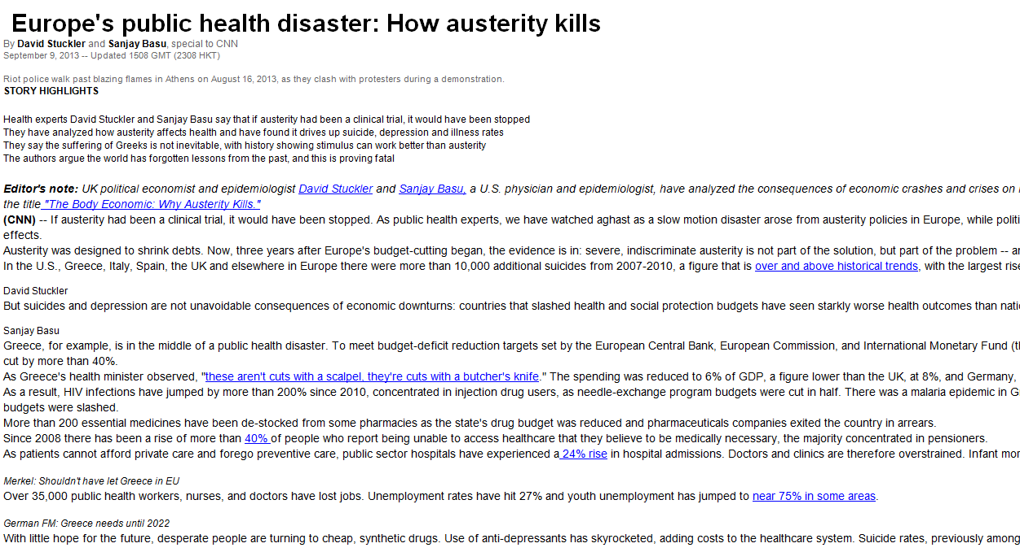
Εurope’s public health disaster: How austerity kills
By David Stucker and Sanjay Basu, special to CNN,
September 9, 2013
Sanjay Basu
Greece, for example, is in the middle of a public health disaster. To meet budget-deficit reduction targets set by the European Central Bank, European Commission, and International Monetary Fund (the so-called troika), Greece's public health budget has been cut by more than 40%.
As Greece's health minister observed, "these aren’t cuts with a scalpel, they’re cuts with a butcher’s knife. “ The spending was reduced to 6% of GDP, a figure lower than the UK, at 8%, and Germany, at 9%.
As a result, HIV infections have jumped by more than 200% since 2010, concentrated in injection drug users, as needle-exchange program budgets were cut in half. There was a malaria epidemic in Greece -- the largest in 40 years -- after mosquito-spraying budgets were slashed.
More than 200 essential medicines have been de-stocked from some pharmacies as the state's drug budget was reduced and pharmaceuticals companies exited the country in arrears.
Since 2008 there has been a rise of more than 40% of people who report being unable to access healthcare that they believe to be medically necessary, the majority concentrated in pensioners.
As patients cannot afford private care and forego preventive care, public sector hospitals have experienced a 24% rise in hospital admissions. Doctors and clinics are therefore overstrained. Infant mortality rates have risen 40% between 2008 and 2010.
EXTRAORDINARY GENERAL ASSEMBLY OF SFEE| 27 November 2013

Slide 4
Review of 2013 actions of Reimbursement Committees
Establishment of committees positive/negative list and reimbursement
Consideration of objections by the committee list
Development of arguments for the INN prescription, % of patient participation, rebates/clawback
Health Technology Assessment (HTA) → evaluation of criteria of innovative drugs
Set criteria for the introduction of L.1836 medicines in GG

Slide 5
Review of 2013 actions of Reimbursement Committees
Consideration of reimbursement of the 103 innovative medicines, priced on August 6th, 2013
Analysis and request for submission of IDIKA data to pharmaceutical companies
Resolution of problems concerning e-prescription ICD-10 and Therapeutic Protocols (in collaboration with Medical Directors)
Participation in the monthly meetings with EOPYY regarding monthly expenditure
Reimbursement of the 400 new drugs pending for pricing
Registries

Slide 6
Thank you

