Slide 1


Truths and lies
for the consumption of medicinal products in Greece
1
1

Slide 2
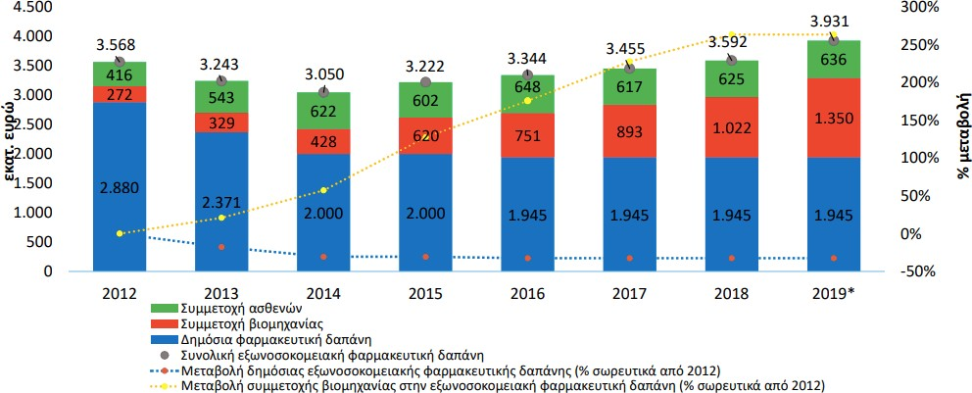
Why are we still discussing about medicinal products in Greece?
Off-hospital expenditure (reimbursed purchase) in Greece: 2012-2019
We are still discussing about it because the problem remains unsolved
Source: ΙΟΒΕ 2020
2

Slide 3
What kind of measures can be implemented in order to manage the pharmaceutical expenditure problem?
Generally speaking, measures for the rationalization of pharmaceutical expenditure can be distinguished, from one extent, to measures:
  “From the top to the bottom”, i.e. measures aiming at defining the expenditure at a macroeconomic (overall) level. Characteristic examples: fixing of the budget level, clawbacks, injections to the budget etc.
  “From the bottom to the top”, i.e. measures aiming at affecting daily interactions, which in the aggregate shape the expenditure (measures at microeconomic level). Characteristic examples: prescription protocols.
3

Slide 4
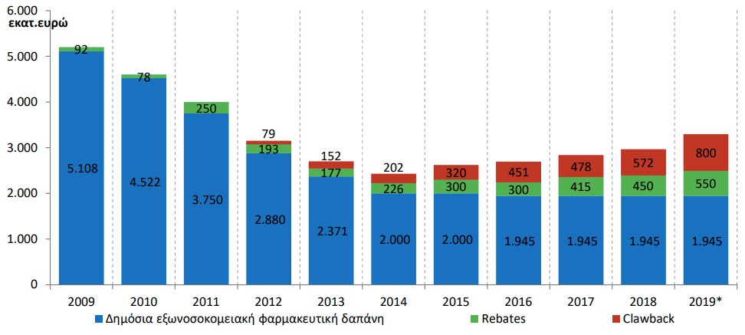
“From the top to the bottom” measures or the rationalization of the market: advantages and restrictions
“From the top to the bottom” measures and their effect on the expenditure:
  They are usually “fire- suppression” measures, with a direct impact
  Their nature however, renders them measures of temporary efficiency. A characteristic example: clawback
Source: ΙΟΒΕ 2020
4

Slide 5
Second characteristic case: Closed budget and shift of expenditure
Off-hospital sales of medicinal products in Greece: 2009-2018
 | 2009 | 2018
Total sales: values in (Euro) | 6.770.606.968 | 4.114.314.394
Total sales: packages | 465.752.093 | 470.874.752
Parallel exports: values | 649.656.941 | 362.614.492
Parallel Exports (PE): packages | 22.043.007 | 19.062.426
Actual sales (excluding PE): packages | 443.709.086 | 451.812.326
Actual sales (excluding PE): values | 6.120.950.027 | 3.751.699.902
Actual sales in constant 2018 prices | 3.684.413.281 | 3.751.699.902
Public pharmaceutical expenditure (nominal prices) | 5.108.000.000 | 1.945.000.000
Public pharmaceutical expenditure (2018 prices) | 3.074.683.335 | 1.945.000.000
Private pharmaceutical expenditure (nominal prices) | 1.012.950.027 | 1.806.699.902
Private pharmaceutical expenditure (2018 prices) | 609.729.946 | 1.806.699.902
Increase in the private pharmaceutical expenditure (2018-2009) |  | 1.196.969.956
Rebates/Clawbacks | 82.000.000 | 1.029.000.000
5

Slide 6
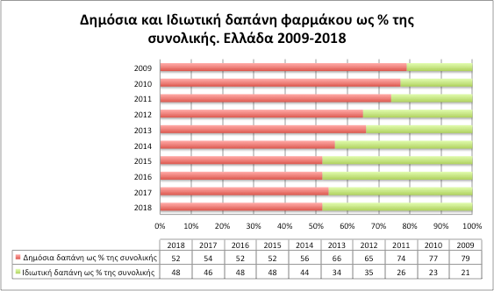
Second characteristic case: closed budget and shift of the expenditure
ΟΟΣΑ 2012-2018 and other calculation
6

Slide 7
“From the bottom to the top measures for the rationalization of the market: the solution to the problem?
“From the bottom to the top” measures and their effect on the expenditure:
  They affect exchanges at a personal level (what medicinal product is administered and to which patient)
  All exchanges affect the total consumption level and thus the expenditure
  Measures of this type have a permanent result, which however will be seen in the non-imminent future
  Measures of this type require a strategic planning, data, tokens and a careful application (as well as feedback, via the use of the data produced)
7

Slide 8
Structure of the medicinal products market and the need for “from the bottom to the top” measures
How is the medicinal products expenditure generated? An analysis of synthetic components
Expenditure = p*(q*n)*r
Consequently the final expenditure is determined by:
- the prices
- the consumption volume
- The composition of the medicinal products “basket”
(new/old ones)
Kyriopoulos 2010, Gerdtham 1998
8

Slide 9
Consumption of medicinal products in Greece
The consumption and the expenditure of medicinal products in Greece is an ongoing – and in part, inconclusive – topic.
Public dialogue on consumption of medicinal products in Greece is characterized by rather arbitrary assessments
  Result of the absence of a reliable source and,
  Consequently, it is characterized by arbitrary conclusions in terms of consumption.
As a result thereof, it could constitute the non-rational basis on which the next measures for the medicinal products policy in the country will be founded.
9

Slide 10
Finally, is the consumption of medicinal products in Greece high or low?
The basis of the Organization for Economic Co-operation and Development (OECD)
  Central informational depository for medicinal products consumption, which is generated with a specific available methodology
  Ability of inter-State and historical comparisons
  Main source of information for policy-making for medicinal products at an international level and in Greece:
  Any attempts/measures applied in Greece in the recent past, have taken into account the OECD data as a criterion for the position of Greece in Europe
10

Slide 11
The database of the Organization for Economic Co-operation and Development (OECD)
Consumption of medicinal products based on the ATC/DDD system
Consumption data for the following categories
ATC Codes (2019 Index) | Description | ATC Codes (2019 Index) | Description
A | GI tract and metabolism | G03 | Sex hormones and modifiers acting in the genital system
A02B | Medicinal products for the treatment of GI ulcer and gastro-esophageal reflux
 |  | H | Hormone preparations, excluding the genital hormones
A10 | Medicinal products administered for diabetes | J | Medicinal products against infections for systematic administration
B | Blood and hematopoietic organs
C | Cardiovascular system | J01 | Antibiotics for systematic administration
C01A | Cardiac Glycosides
C01B | Antiarrhythmic medicinal products. Categories I and ΙΙΙ | M | Medicinal products for arthropathies and myosceletal diseases
C02 | Antihypertensive medicinal products | M01A | Non-steroidal anti-inflammatory drugs and antirheumatic drugs
C03 | Diuretic medicinal products
 |  | N | Nervous system
C07 | B-adrenergic receptors blockers
 |  | N02 | Analgesics
C08 | Calcium canal blockers
 |  | N05B | Tranquilizers
 |  | N05C | Hypnotics and sedatives
C09 | Antihypertensive factors acting in the renin-angiotensin system | N06A | Antidepressants
 |  | R | Respiratory system
C10 | Hypolipidemic agents | R03 | Medicinal products for air tract blocking diseases
G | Urogenital system and sex hormones
Πηγή: OECD Health Statistics 2019
Deﬁnitions, Sources and Methods: Pharmaceutical consumption by DDDs
11

Slide 12
The database of the Organization for Economic Co-operation and Development (OECD)
Data availability:
  From 2000 and forth. Almost for all countries, information on all listed categories is available for the past five years
  27 countries
  The major European countries participate
  Ability to create inter-State comparisons
  Important element: information in relation to the legal basis of the products included in the database is available
    Drugs dispensed in hospitals
    Inclusion/Non inclusion of non-reimbursed drugs
    Inclusion/Non inclusion of OTC drugs
    Ability to compare Greece with clearly respective countries or analysis under certain assumptions
12

Slide 13
Examining the medicinal products consumption in Greece and the EU
Exploitation of the available data of OECD in relation to the pharmaceutical consumption
Reference year: 2017 and 2018, with respect to the data availability.
  Direct readjustment of the exercise with updating of the database
Measuring Unit Index: Defined Daily Dose (DDD)* per 1000 habitants per day
Classification of medicinal products: per main ATC Cluster and then at a second or third level of each main ATC cluster, if data exists
Methodological differences in recording consumption of medicinal products in the OECD database:
  In some countries, in contrast to Greece, the OTC, non-reimbursed or medicinal products distributed to hospitals are included in the calculation of the consumption of medicinal products.
* Defined daily dose is the average daily preservation dose in grams of a medicinal products which is administered, based on the official indications thereof, to an adult patient
13

Slide 14
Examining the medicinal products consumption in Greece and the EU
European countries of the OECD included in the analysis
Country | Medicinal products distributed in hospitals | Non-reimbursed medicinal products | OTC | Country | Medicinal Non-reimbursed products OTC in hospitals
Austria | ✕ | ✕ | ✕ | Italy | Ν/Α ✕ ✕
Belgium | ✕ | ✕ | ✕ | Latvia | Ν/Α Ν/Α Ν/Α
Czech R. | ✓ ✓ |  | ✓ | Lithuania | ✓ ✓ ✓
Denmark | ✓ ✓ |  | ✓ | Luxemburg | ✕ ✕ ✕
Estonia | ✓ ✓ |  | ✓
Finland | ✓ ✓ |  | ✓ | The Netherlands | ✕ ✕ ✕
France | ✓ ✓ |  | ✓ | Norway | ✓ ✓ ✓
Germany | ✕ | ✕ | ✕ | Portugal | ✕ ✓ ✓
Greece | ✕ | ✕ | ✕ | Slovakia | ✓ ✓ ✓
Hungary | (up to 2006) | (up to 2006) | (up to 2006) | Slovenia | ✕ ✓ ✓
 |  |  |  | Spain | ✕ ✕ ✕
Ireland | Ν/Α | Ν/Α | Ν/Α | Sweden | ✓ ✓ ✓
Iceland | ✓ ✓ |  | ✓ | United Kingdom | ✕ ✕ Ν/Α
✕: no, ✓: yes, N/A: not available data
OECD Health Statistics 2019
Deﬁnitions, Sources and Methods: Pharmaceutical consumption by DDDs
14

Slide 15
Α1) Consumption of medicinal products per main ATC clusters in Greece and the OECD European Countries
600
Greece presents the higher consumption
DDD per 1000 habitants per day
500
482.1
In the main clusters ATC B & J, while it presents the lower in all other clusters
443.5
400
300
240.6
223.1
193.1
200
185.5
14
2.4
143.
5
107.9
74.9
100
34.4
62.4
39.9
38.8
66.9
20.4
23.5 19,3
0
A
B
C
G
H
Main ATC cluster
J
M
N
R
Greece Average of OECD European countries
Reference year: 2017
European countries of the OECD: Greece, Austria, Belgium, Czech Republic, Denmark, Estonia, Finland, France, Germany, Hungary, Iceland, Italy, Latvia, Lithuania, Luxemburg, The Netherlands, Norway, Portugal, Slovakia, Slovenia, Spain, Sweden and United Kingdom
Source: OECD Stat and own calculations
15

Slide 16
Results: Α1) Consumption of medicinal products per ATC cluster in Greece and the OECD European countries
Greece shows the higher consumption in the main ATC B & J clusters and the lower in all other clusters.
The highest differences are noticed in the main ATC clusters B-blood and hematopoietic organs (+56.7%), H-hormone preparations, except of genital hormones (-48.9%), G-urogenital system and sex hormones (-44.8%), M- arthropathy and myoskeletal diseases drugs (-42.0%) and R- respiratory system. (-30.5%)
Main ATC Cluster | A | B | C | G | H | J | M | N | R
Greece | 185.5 | 223.1 | 443.5 | 34.4 | 20.4 | 23.5 | 38.8 | 143.5 | 74.9
Average of OECD European Countries | 240.6 | 142.4 | 482.1 | 62.4 | 39.9 | 19.3 | 66.9 | 193.1 | 107.9
Percentile difference | -22,9% | +56,7% | -8,0% | -44,8% | -48,9% | +21,9% | -42,0% | -25,7% | -30,6%
Έτος αναφοράς: 2017
Ευρωπαϊκές χώρες του ΟΟΣΑ: Ελλάδα, Αυστρία, Βέλγιο, Τσεχία, Δανία, Εσθονία, Φιλανδία, Γαλλία, Γερµανία, Ουγγαρία, Ισλανδία, Ιταλία, Λετονία, Λιθουανία, Λουξεµβούργο, Ολλανδία, Νορβηγία, Πορτογαλία, Σλοβακία, Σλοβενία, Ισπανία, Σουηδία και Ηνωµένο Βασίλειο
Source: OECD Stat and own calculations
16

Slide 17
Α2) Consumption of medicinal products per second and third ATC level in Greece and in the OECD European Countries
250.0
Greece presents the highest
DDD per 1000 habitants per day
Consumption in 7/18 ATC at the second and third level.
200.0
191.6
It presents the lowest consumption in 11/18
173.7
150.0
116.0 108.3
100.0
77.1 _{80.7}
72.1
68.6
50.4
63.0
50.9
55.6
55.1
48.3
50.0
28.3
42.5
45.2
34.6 32.1
45.4
32.1
21.3
45.6
7.0
9.7
5.7
18.0
25.3
20.3
1.9 2.3
4.8
3.7
C03 C07 C08 C09 C10 G03
ATC Cluster
9.2
1.2
6.5
0.0
A02B A10 C01A
C01BC02
J01 M01A
N02 N05B N05C N06A R03
Greece Average of OECD European Countries
Reference year: 2017
European countries of the OECD: Greece, Austria, Belgium, Czech Republic, Denmark, Estonia, Finland, France, Germany, Hungary, Iceland, Italy, Latvia, Lithuania, Luxemburg, The Netherlands, Norway, Portugal, Slovakia, Slovenia, Spain, Sweden and United Kingdom
Source: OECD Stat and own calculations
17

Slide 18
Α2) Consumption of medicinal products per second and third ATC level in Greece and in the OECD European Countries
Greece presents the highest consumption in Clusters A10, C01Β, C07, C10, J01, NO5B and R03 and the lowest in all other clusters.
The highest differences are noticed in Analgesics (-95,3%), G03-Sex hormones and modifiers effecting the genital system (-89,3%), Μ01Α- Non-steroidal anti-inflammatory drugs and antirheumatic drugs (-79,9%), J01-Antibiotics for systematic adminstration
(+78,4%), Hypnotics and sedatives (-68,1%) και C01B-Antiarrythmic, Clusters Ι and ΙΙΙ (+46,4%)
ATC Cluster | A02B | A10 | C01A | C01B | C02 | C03 | C07 | C08 | C09 | C10 | G03 | J01 | M01A | N02 | N05B | N05C | N06A | R03
Greece | 72.1 | 80.7 | 1.9 | 7.0 | 5.7 | 28.3 | 50.9 | 45.2 | 173.7 | 116.0 | 3.7 | 32.1 | 9.2 | 1.2 | 25.3 | 6.5 | 55.1 | 48.3
Average of OECD European Countries | 77.1 | 68.6 | 2.3 | 4.8 | 9.7 | 42.5 | 50.4 | 55.6 | 191.6 | 108.3 | 34.6 | 18.0 | 45.4 | 32.1 | 21.3 | 20.3 | 63.0 | 45.6
Percentile difference | -6,5% | +17,6% | -17,1% | +46,4% | -40,9% | -33,4% | +1,1% | -18,7% | -9,3% | +7,1% | -89,3% | +78,4% | -79,7% | -96,3% | +18,7% | -68,1% | -12,5% | +5,9%
Έτος αναφοράς: 2017
Ευρωπαϊκές χώρες του ΟΟΣΑ: Ελλάδα, Αυστρία, Βέλγιο, Τσεχία, Δανία, Εσθονία, Φιλανδία, Γαλλία, Γερµανία, Ουγγαρία, Ισλανδία, Ιταλία, Λετονία, Λιθουανία, Λουξεµβούργο, Ολλανδία, Νορβηγία, Πορτογαλία, Σλοβακία, Σλοβενία, Ισπανία, Σουηδία και Ηνωµένο Βασίλειο
Source: OECD Stat and own calculations
18

Slide 19
Β1) Consumption of medicinal products per main ATC cluster in Greece and European countries which apply the same reporting methodology with Greece
600
Greece presents the highest consumption in the main ATC Clusters B & J and the lowest in all others.
DDD per 1000 habitants per day
500
483.4
443.5
400
300
257.9
223.1
200
185.5
160.9
143.5
127.4
100
57.4
74.9 78.5
34.4 42.5
20.4
41.5
23.5
18.0
38.8
0
A
B
C
G
H
Main ATC Cluster
J
M
N
R
Greece Average of European Countries with similar reporting methodology with Greece
Reference year : 2017
OECD European countries with similar reporting methodology with Greece : Belgium, Germany, Hungary, Luxemburg, the Netherlands and Spain
Source: OECD Stat and own calculations
19

Slide 20
Β1) Consumption of medicinal products per main ATC cluster in Greece and European countries which apply the same reporting methodology with Greece
Compared to the previous analysis (A), the differences are less noticeable, with the exception of ATC Clusters Α,B & J.
As in the previous analysis, Greece presents the highest consumption in Clusters B & J and the lowest in all other Clusters.
The highest differences are noticed in the main ATC clusters B-blood and hematopoietic organs (+75.1%), H-hormone preparations, except of genital hormones (-50.9%), M- arthropathy and myoskeletal diseases drugs (-32.4%)
Main ATC Cluster | A | B | C | G | H | J | M | N | R
Greece | 185.5 | 223.1 | 443.5 | 34.4 | 20.4 | 23.5 | 38.8 | 143.5 | 74.9
Average of OECD European countries with similar reporting methodology with Greece | 257.9 | 127.4 | 483.4 | 42.5 | 41.5 | 18.0 | 57.4 | 160.9 | 78.5
Percentile difference | -28,1% | +75,1% | -8,3% | -19,0% | -50,9% | +30,3% | -32,4% | -10,8% | -4,5%
Reference year: 2017
OECD European countries with similar reporting methodology with Greece : Belgium, Germany, Hungary, Luxemburg, the Netherlands and Spain
Source: OECD Stat and own calculations
20

Slide 21
Β2) Consumption of medicinal products per second and third ATC cluster in Greece and European countries which apply the same reporting methodology with Greece
250.0
Greece presents the highest consumption in ATC 6/18 at the second level and the lowest consumption in 12/18 at the third level
DDD per 1000 habitants per day
200.0
199.6
173.7
150.0
116.0
111.8
100.0 87.2 _{80.7}
72.1 71.8
50.9
40.0
52.7
46.9
55.1 57.3
44.5
50.0
45.2
32.1
25.3
48.3
7.0
5.0
10.3
5.7
28.3
20.3
31.0
21.8
22.8
1.9
17.3
9.2
14.2
2.0
3.7
1.2
6.5
0.0
C02 C03 C07 C08 C09 C10 G03 J01 M01A
Ομάδα ATC
A02B A10 C01A C01B
N02 N05B N05C N06A R03
Greece
Average of European Countries with similar reporting methodology with Greece
Reference year: 2017
OECD European countries with similar reporting methodology with Greece : Belgium, Germany, Hungary, Luxemburg, the Netherlands and Spain
Source: OECD Stat and own calculations
21

Slide 22
Β2) Consumption of medicinal products per second and third ATC cluster in Greece and European countries which apply the same reporting methodology with Greece
Greece presents the highest consumption in Clusters A10, C01Β, C10, J01, NO5B and R03 and the lowest in all others.
The highest differences are noticed in Clusters N02-Analgesics (-94.5%), J01-Antibiotics for systematic administration (+86.1%), G03- Sex Hormones
And modifiers effecting the genital system (-81.8%), M01A- Non – steroidal anti--inflammatory drugs and antirheumatic drugs (-70.3%), N05C-Hypnotics and sedatives (-54.2%), C02-Antihypertensive (-44.7%) and C01B-Antiarrythmic, Clusters Ι and ΙΙΙ (+41.1%)
ATC Cluster | A02B | A10 | C01A | C01B | C02 | C03 | C07 | C08 | C09 | C10 | G03 | J01 | M01A | N02 | N05B | N05C | N06A | R03
Greece | 72.1 | 80.7 | 1.9 | 7.0 | 5.7 | 28,. | 50.9 | 45.2 | 173.7 | 116.0 | 3.7 | 32.1 | 9.2 | 1.2 | 25.3 | 6.5 | 55.1 | 48.3
Average of OECD European countries with similar reporting methodology with Greece | 87.2 | 71.8 | 2.0 | 5.0 | 10.3 | 40.0 | 52.7 | 46.9 | 199.6 | 111.8 | 20.3 | 17.3 | 31.0 | 21.8 | 22.8 | 14.2 | 57.3 | 44.5
Percentile difference | -17,3% | +12,4% | -6,2% | +41,1% | -44,7% | -29,2% | -3,3% | -3,5% | -13,0% | +3,8% | -81,8% | +86,1% | -70,3% | -94,5% | +10,8% | -54,2% | -3,8% | +8,6%
Reference year: 2017
OECD European countries with similar reporting methodology with Greece : Belgium, Germany, Hungary, Luxemburg, the Netherlands and Spain
Source: OECD Stat and own calculations
22

Slide 23
Certain Conclusions
Apart from some exceptions, results show that the consumption of medicinal products in Greece is near (or below) the average of the OECD countries
This fact shows that the medicines policy needs to turn to measures for the other two components of the expenditure, in order to be successful
The management of major problems in the market will require measures of a fiscal (from the top to the bottom) and a reforming (from the bottom to the top) nature. For example, a proposal for the resolution of the clawback issue could include the following:
23

Slide 24
Resolving the clawback issue: a proposal to be discussed
A series of points for managing the clawback issue in the short- and in the long-run
A proposal founded on the structural characteristics of the medicinal products market in Greece and on the fiscal requirements
Presentation and consultation on the initial points in a meeting between experts
Final points after including the views of the parties involved
24

Slide 25
Section Α. Immediate effect measures
Prompt re-pricing of all medicinal products. External reference prices without increases.
  Accompanied by economic incentives for the selection of alternative generics at a personal level (patients, pharmacists)
Voluntary price decrease
  The overall price decrease shifts to the participation of the user
Removal from the “type ΗΤΑ“ process of biosimilars and generics (concerns both “committees”)
  Pricing by a maximum rate of the price of the reference product
25

Slide 26
Section Α. Immediate effect measures
“Direct” negotiations for the 10 major therapeutic clusters
  Horizontal negotiations with all MAHs per cluster
  Non-disclosed horizontal rebate – subtraction from the CB
  No agreement = No reimbursement
  Cutting down of expenditure around Euro 350 m.
  Effective period of the measure: max of 2 years, since it establishes strong distortions
Formation of the “Chief EOPYY Physician” institution
  Insurance directions production team
  Focus on selection of treatments with the maximum efficiency (generics-biosimilars at the front line etc.)
26

Slide 27
Section Β. Structural/Long-term measures
Prescription measures focusing of the consumption mix. Connection of the prescription system (protocol) with the informational systems of the laboratories
“Normalization” of the packages of marketed generics
Escalated joint responsibility over a certain limit of the clawback, in order to deal with the “ethical danger” in the creation of a health policy
Proportional subtraction of amounts for investments in research, capital and labour from the calculation of the clawback when clawback exceeds a specific limit
27

Slide 28
Section Β. Structural/Long-term measures
Settlement of prior debts in monthly instalments which may be offset against the MAHs receivables
Formation of an analysis team for e-prescription and a team that will follow-up the course of negotiations, in EOPYY
Total restructuring of the HTA process, based on the internationally applied accepted standard
Revision of the “positive list”
Clarification of accounting sizes (clawback calculation in retail prices, VAT issues etc.)
28

Slide 29
Section Β. Structural/Long-term measures
Introduction of negotiations systems. Separation of negotiations from the HTA (except of the entry negotiations). Negotiations at a ATC5 or ATC4 level to the competency of monopsony
Reinforcement of procedures within the context of the controlled entry agreements, focusing on the “price-volume" and “risk-sharing“ agreements
29

